Slide 1
HoopFinder
Iteration 2

Slide 2
Iteration 2 Overview.
Tasks from Iteration 1:
User login
Instead creating user login; only using facebook login
User id and email address is stored in Firebase DB
Planned tasks for Iteration 2:
User can receive push notification when near a court location
User can receive text notification when near a court location
Location table for courts in DB

Slide 3
Completed User cases
Completed user stories:
User can receive push notifications when near a court location
User can receive a text notification to ‘hard coded’ number
User stories in progress:
User can receive text notifications when near a court location
Retrieving user phone number from Firebase.
User can view nearby court locations.
Pull data from DB and display to the user.

Slide 4
Metrics
 | 0 | 1 | 2 | 3 | 4 | 5
# hours worked | 15 | 25 | 25* | - | - | -
# defects | 0 | 0 | 2 | - | - | -
# lines of code | 0 | 34 | 479 | - | - | -
# user stories added | 0 | 1 | 2 | - | - | -
# class files | 0 | 3 | 6 | - | - | -

Slide 5
Issues
Need to finalize the storyboard for the remaining pages.
Need to define the database architecture for:
Court details
User subscriber
Court subscriber

Slide 6
Demo

Slide 7
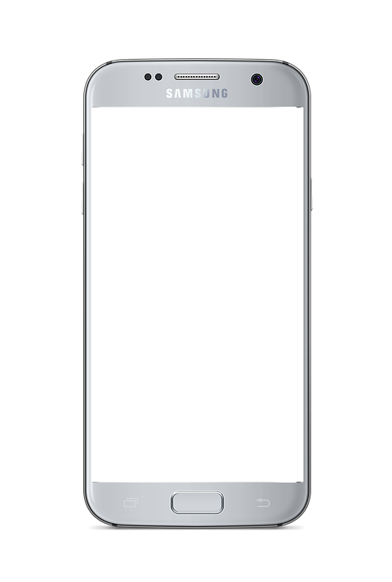
HoopFinder
Username
Password
Confirm password
REGISTER

Slide 8
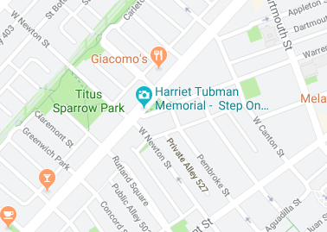


HoopFinder
MAP
FRIENDS
1 court near you!
3 ballers nearby

Slide 9
HoopFinder
MAP
FRIENDS
Friends
jumpinjack
speedsteve
hooper312
hgtwb88
ADD FRIENDS

